Slide 1


APNA SAHARA
Your Kindness Can Change Someone’s World

Slide 2
INTODUCTION
APNA SAHARA aims to inspire a culture of generosity and social responsibility by ensuring that every contribution reaches the right people. Through meaningful connections and community support, we strive to create a positive impact and make every act of kindness count.
01
Guided by the motto, "your kindness can change someone's world," APNA SAHARA promotes kindness, social responsibility, and community participation by ensuring every contribution creates a meaningful impact.
The platform enables users to donate essential items while helping organizations efficiently manage donations and support those in need.
02

Slide 3
PROBLEM STATEMENT
Many people are willing to donate but often struggle to find trustworthy organizations and a simple way to contribute. At the same time, charitable organizations face challenges in managing donations, maintaining records, and communicating their needs.
Traditional donation methods are often manual, leading to poor record management, limited transparency, and difficulties in tracking donations. These challenges reduce the overall efficiency of the donation process.

Slide 4
OUR MISSION
APNA SAHARA provides a centralized and user-friendly platform that simplifies the donation process by connecting donors with charitable organizations. It enables users to donate essential items, maintain donation records, and track their contributions with ease.
The platform also helps organizations manage donation requests and records efficiently, improving coordination, transparency, and accountability. By digitizing the entire process, it makes charitable giving more organized, reliable, and accessible for everyone.

Slide 5
OUR VISION
To empower communities by creating a trusted donation ecosystem where every contribution brings hope, every donor inspires change, and every act of kindness transforms lives.

Slide 6
OBJECTIVES
To develop a secure and user-friendly charity donation management platform.
To simplify the donation process for donors and charitable organizations.
To provide a transparent system for managing and tracking donations.
To maintain accurate records of donors, organizations, and donation activities.
To improve coordination and communication between donors and charitable organizations.
To encourage community participation and promote the spirit of helping those in need.

Slide 7
FEATURES
User Registration & Login
Donation Request Management
Role-Based Authentication
Organization & Donor Management
Donation Management
Donation Categories
Image Upload Support
Donation History Tracking
Admin Dashboard
CRUD Operations
Responsive User Interface
Secure Record Management

Slide 8
Core Application Structure
Combines multiple Node.js modules into one application. Combines multiple Node.js modules into one application.
Uses different routes for different functionalities.
Uses the http module to handle requests and responses.
Routing controls application flow using URLs.
Handles errors using callback functions.
Easy to extend with new routes and features.
Demonstrates Node.js core concepts and asynchronous programming.

Slide 9
Core Application Structure
Q . Why didn't we use the fs module?
Ans. I didn't use the fs.readFile() and fs.writeFile() methods because my project uses MongoDB as the database. Those methods are typically used to read from and write to files, such as JSON or text files. Since my data is stored in MongoDB, I use Mongoose methods like save(), find(), update(), and delete() instead.
Q. Why didn't we use JSON/Text files?
Ans. I chose MongoDB instead of JSON or text files because I plan to continue developing this project in the future. As the application grows, it will need to manage a larger amount of data and more users. MongoDB provides better scalability, security, efficiency, and reliability, making it a more suitable choice for a real-world web application.

Slide 10
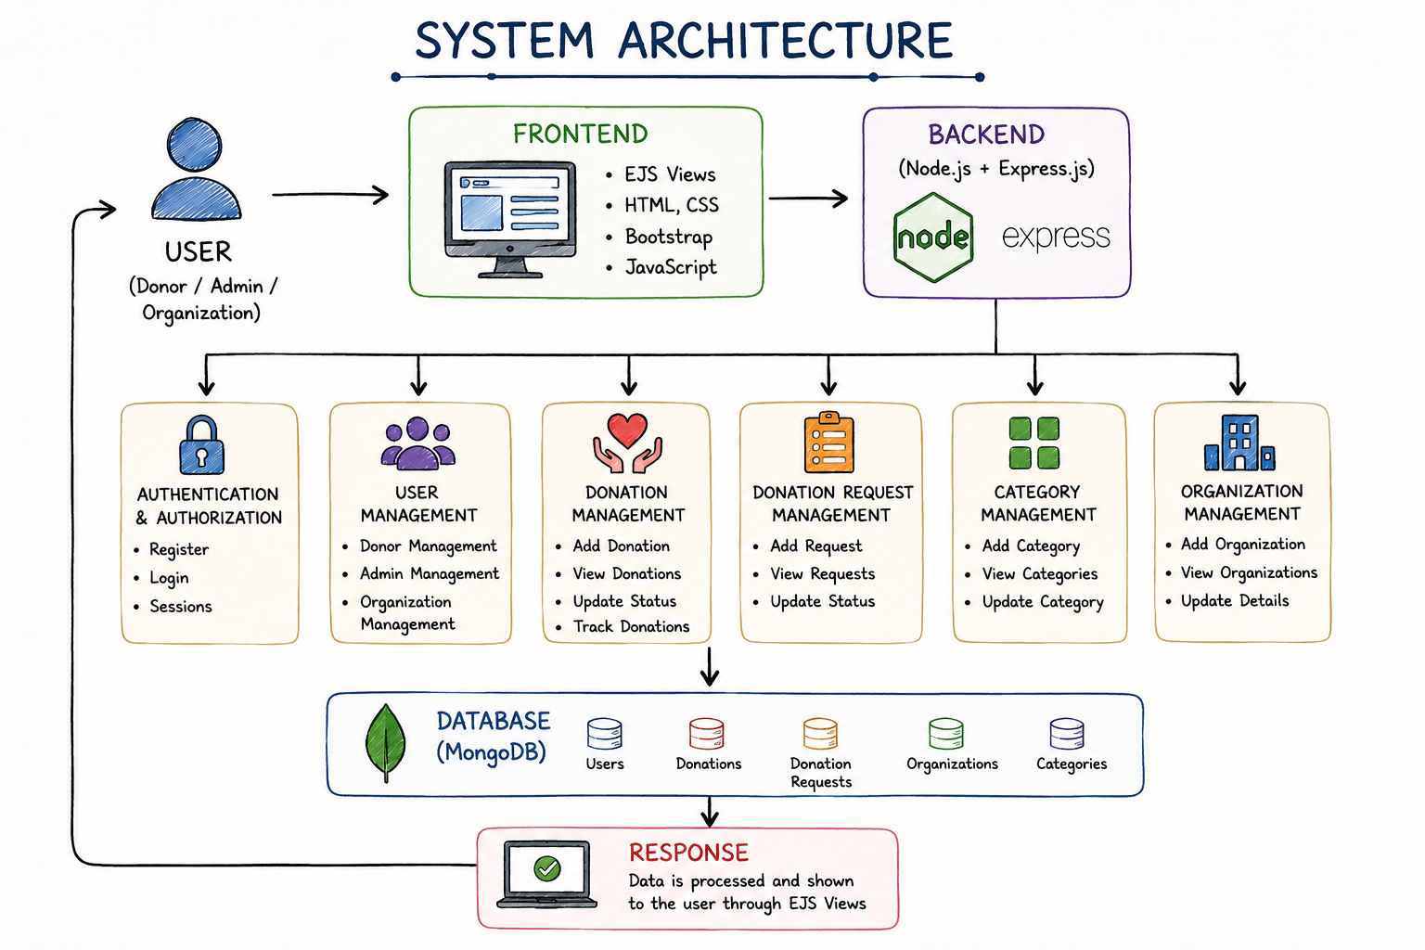
SYSTEM ARCHITECTURE

Slide 11
MODULES
USER MODULE
ADMIN MODULE
User Registration
Secure Login
Profile Management
Make Donation
Upload Donation Image
View Donation History
View Donation Details
Logout
Admin Login
Dashboard
Manage Donors
Manage Donations
Manage Organizations
Manage Donation Requests
Manage Donation Categories
Update Donation Status
Delete Records
Logout

Slide 12
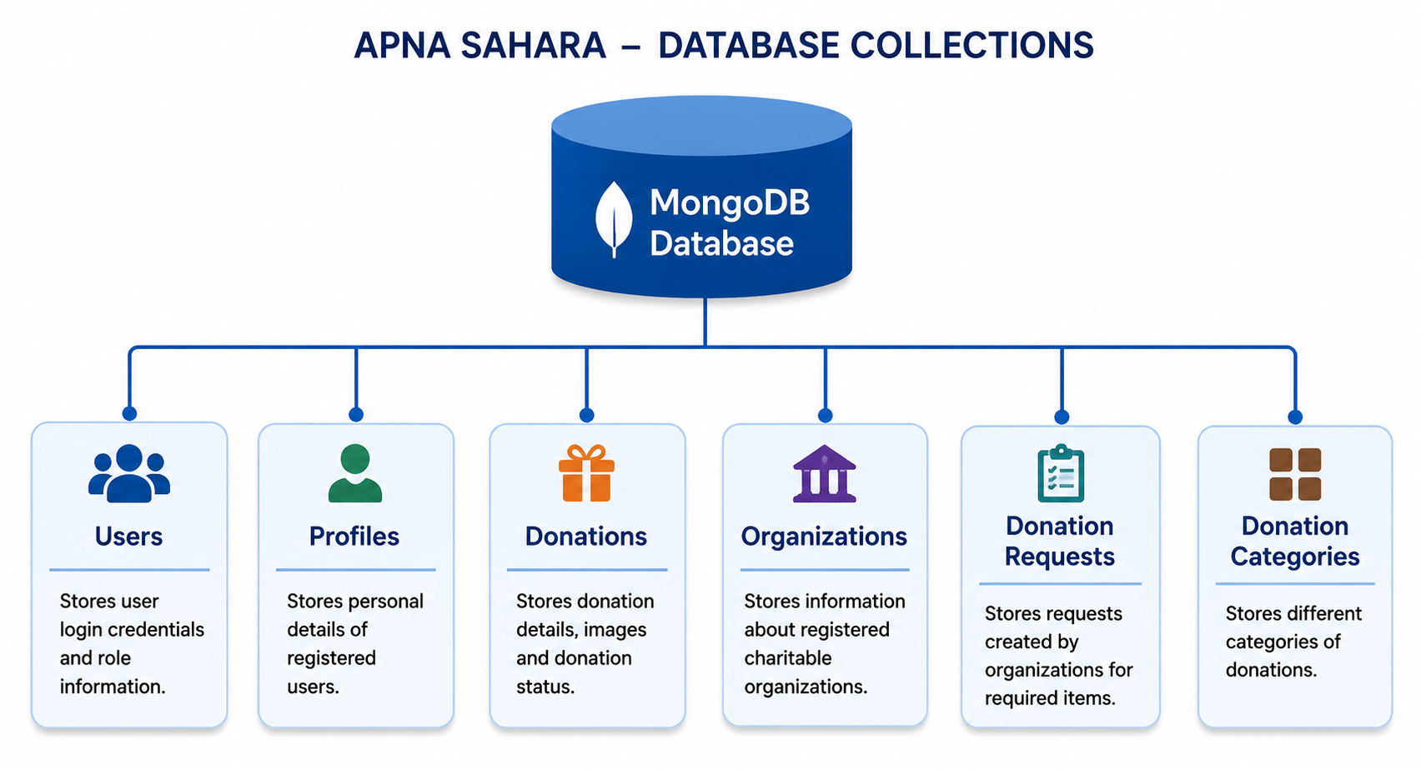
DATABASE COLLECTION

Slide 13
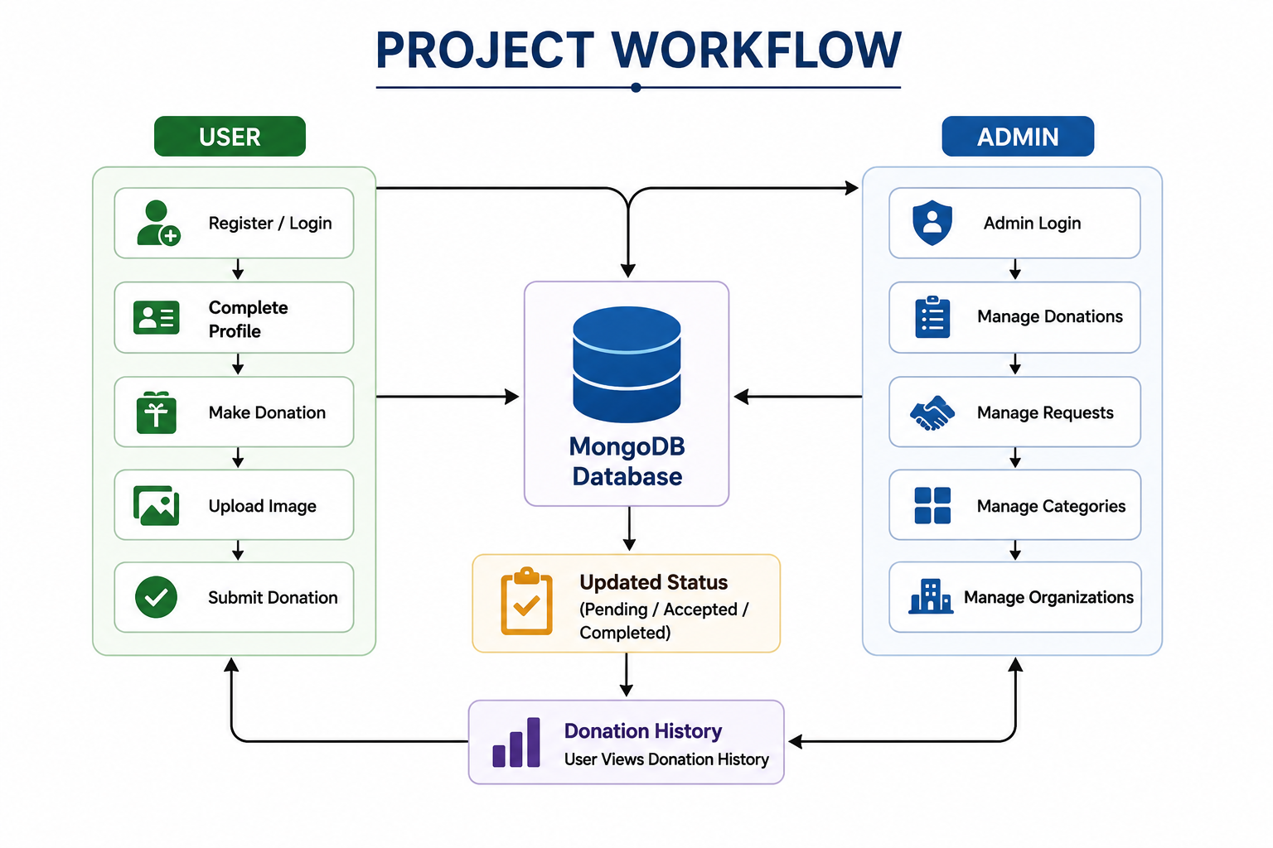
PROJECT WORKFLOW

Slide 14
FUTURE ENHANCEMENT
Real-Time Donation Tracking – Allow donors to track the status of their donations in real time.
Online Payment Integration – Support secure monetary donations through payment gateways.
Mobile Application – Develop Android and iOS apps for easier access.
Email & SMS Notifications – Send instant updates for donation status and requests.
Location-Based Donation Matching – Connect donors with nearby NGOs and beneficiaries.
AI-Based Donation Recommendations – Suggest suitable organizations and donation categories based on user preferences.
QR Code Verification – Enable quick verification and secure donation confirmation.
Analytics & Reports – Provide detailed dashboards and reports for administrators.
Multi-Language Support – Make the platform accessible in multiple regional languages.
Cloud Deployment – Host the application on the cloud for improved scalability, security, and availability.

Slide 15
CONCLUSION
APNA SAHARA is built with the vision of transforming the way people donate and support those in need. By creating a trusted digital ecosystem for donors and charitable organizations, the platform encourages transparency, collaboration, and social impact.
As the platform evolves with new features and wider adoption, APNA SAHARA has the potential to become a leading social-tech startup, making every contribution more meaningful and creating a future where helping others is simple, accessible, and impactful.

Slide 16


